Slide 1
Demonstration of Heritage Health Member Portal Automated Health systems

Slide 2
Register
Log in at www.neheritagehealth.com
Select
Select
Register as a new user

Slide 3
verification
Provide identity verification data

Slide 4
Create an Account
Only if you are the head of household or verified as 19 years or older

Slide 5
Requirements
Read the Member Rights, Responsibilities, and Privacy Policy
Electronic signature is required

Slide 6
Registration Confirmation

Slide 7
Registration E-mail

Slide 8
log in
Once registration is confirmed, member is able to log in to the member portal

Slide 9
Accept the Policy
Every time a member logs in to access their record they must accept the Member Rights, Responsibilities and Privacy Policy

Slide 10
Failed Log In
After 3 failed attempts to log in, the account will be locked
The password will need to be reset

Slide 11
Reset Password
Start from the login page
Click Forgot password or Reset password

Slide 12
Email Reset
An e-mail will be generated to reset password

Slide 13
Fill Out Information
Complete the required information
Click “Reset”

Slide 14
Case/Enrollment Status View
Notes:
Waiting de-identified screen shot

Slide 15
Enrollment Wizard
Notes:
Waiting de-identified screen shot

Slide 16
Plan Selection Tools
The member selects the health plan(s) he/she wishes to submit enrollment/change requests for
Online choice counseling tools:
Search for all PCPs, specialists, and hospitals in the HHEB provider network
Search for and select specific providers and hospitals
Choices are logged and displayed along with the health plans in which they are available
Compare plans by clicking on “See Comparison Chart.”

Slide 17
Plan Selection Screen
Once a choice has been made, the client selects the desired health plan and PCP (not required) and click “Next” to move ahead
Notes:
Waiting de-identified screen shot

Slide 18
Enrollment Summary
Notes:
Waiting for de-identified screen shot

Slide 19
Enrollment Confirmation
Notes:
Waiting for de-identified screen shot

Slide 20
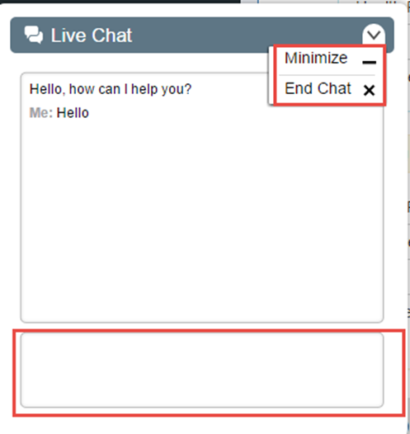
Live Chat
Live Chat can be initiated by clicking the live chat icon on the bottom left corner of the member page

Slide 21
Enroll: Phone
IVR (automatic enrollment)
1-888-255-2605 and select prompt #3
Information you will need
date of birth (2digit month/day and 4digit year) then, press #
last 4 of SS then, press #
4digit PIN then, press #
Select 1, 2 or 3 for plan (they are listed in different order with each call)
System will repeat back the name of the plan selected
If correct, press 1
To make a different selection, press 2
Choice Counselor
1-888-255-2605 and select prompt #2
Verify identity
Member name
3 of 5 identifiers: address, PIN, DOB, SSN, Medicaid ID #
If member wants someone else to assist with process, member must give verbal permission for this one call
If member is unable to speak for themselves, must have the authorized representative form completed (guardian, POA, etc.)
Once verified, call center choice counselors will assist with making selection of plan

Slide 22
Enroll by Mail & Fax
Mail
Complete Plan selection form (head of household or member 19 or older for self)
Mail form to Heritage Health 9370 McKnight Road Suite #300 Pittsburgh, PA 15237
Fax
Complete Plan selection form (head of household or member 19 or older for self)
Fax enrollment form to 1-800-852-6311

Slide 23
Please don’t hesitate to contact us
Heritage Health Call Center
1-888-255-2605
TTY/TTD: 711
www.neheritagehealth.com

